Slide 1
TFM
Safety Reachable sets
vehicle
Highways
HWY Reachable sets
State
Platoon Reachable sets
Type
Highway
Platoon
Platoon
vehicle
State
vehicle
Platoon
Type
vehicle

Slide 2
Target entry point
Base create platoon reachable set
Waypoints
(control sequence)
TFM
Vehicle type
Highway orientation, velocity
Platoon next available position
Base join platoon reachable set
Waypoints
(control sequence)
Vehicle types
Highway orientation, velocity
Vehicle states
Base safety reachable set
Waypoints
(control sequence)
Vehicle types

Slide 3
Vehicle responsibilities
Each vehicle registers itself with TFM before it flies
Deregisters when vehicle gets to destination
Each vehicle reigsters platoon with TFM when it forms a platoon
Deregisters when platoon is dissolved
Platoon
vehicle
TFM
vehicle
vehicle
vehicle

Slide 4
TFM Responsibilities
Maintain a list of ”active agents”
Includes free vehicles, platoons
Excludes follower vehicles
For each active agent, check safety against all other active agents
Combinatorial explosion here, but most of the time, only distances need to be checked
For each vehicle in the platoon, check safety with neighbors

Slide 5
TFM
Platoon
vehicle
vehicle
Platoon
vehicle
vehicle
vehicle
vehicle
vehicle
vehicle
vehicle

Slide 6
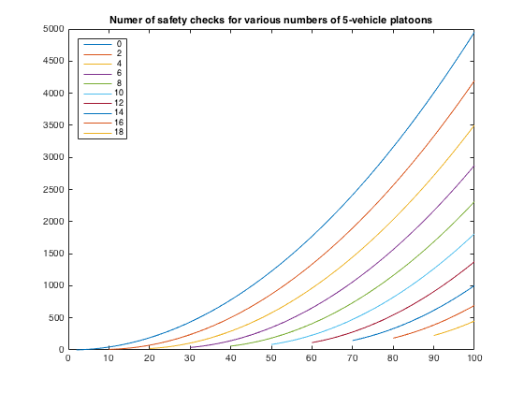
Number of safety checks
All N vehicles are free:
N choose 2
Combinatorial, doesn’t necessarily guarantee safety especially for large N
N = 15 => 105 checks
n free vehicles + p platoons with k vehicles in each
(n+p) choose 2 + (k-1)*p
p = 3, k = 4, n = 3 (so that n + pk = N = 15) => 6 choose 2 + 3 * 3 = 24 checks

Slide 7
Type of safety checks
Active agents
Quick check: distance
Detailed check: safety reachable set
Vehicles within platoons
Quick check: state error (with respect to phantom state)
Detailed check: safety reachable set

